Slide 1
Azure Function APP

Slide 2
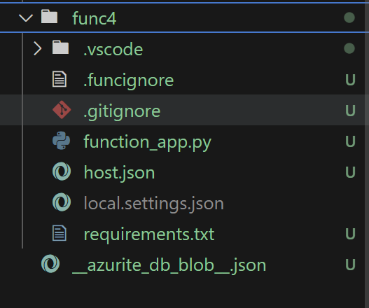
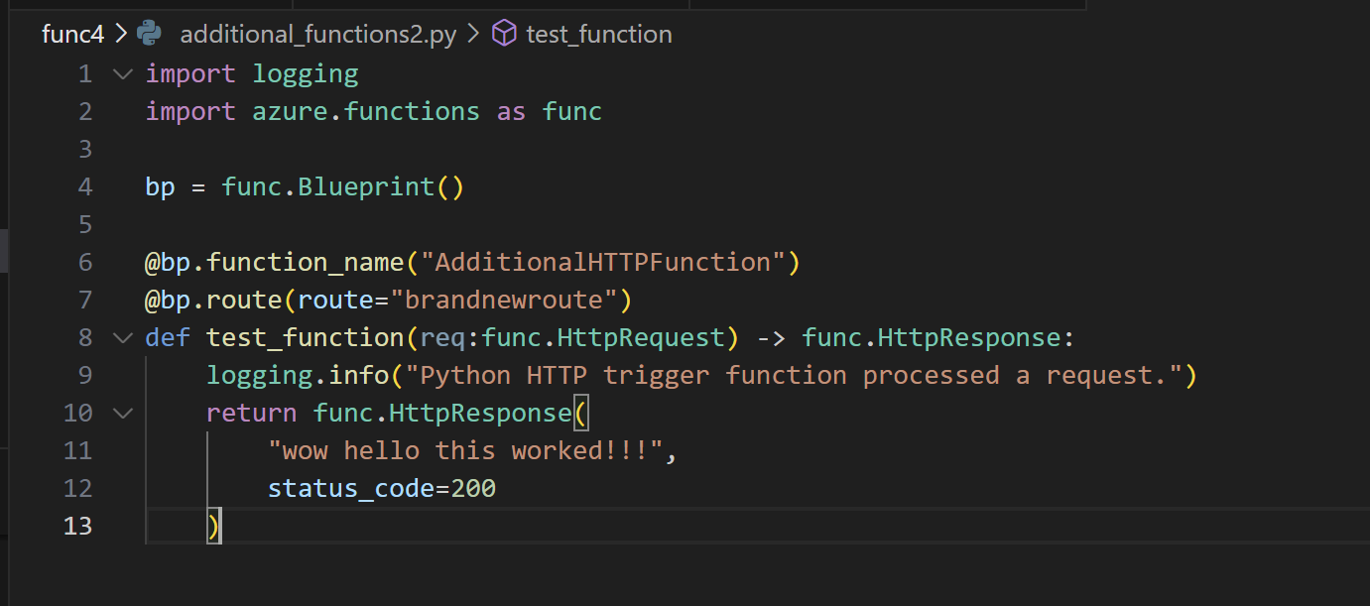
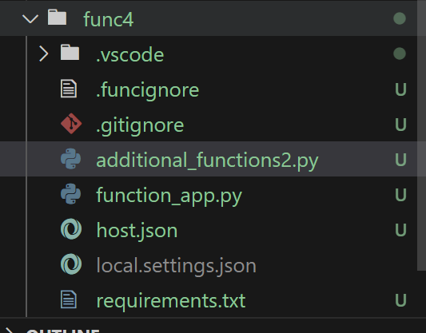
Python programming model
Func init func4
Add addition_function2.py (using blueprint to merge)

Slide 3
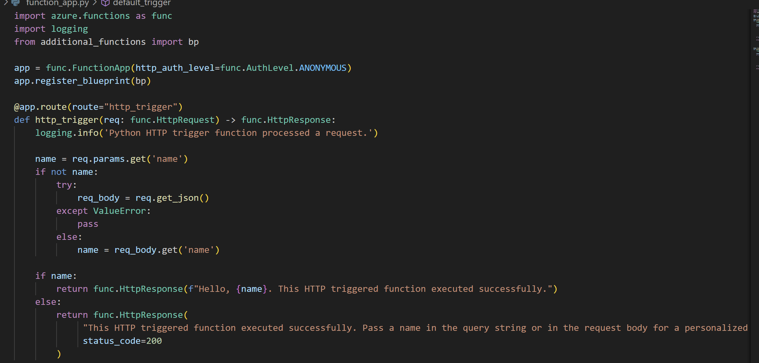
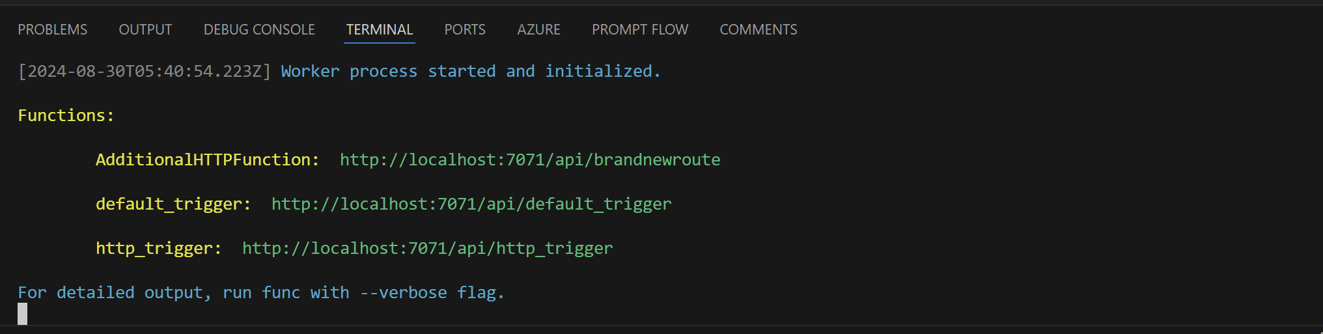
Function_app.py
Func start

Slide 4
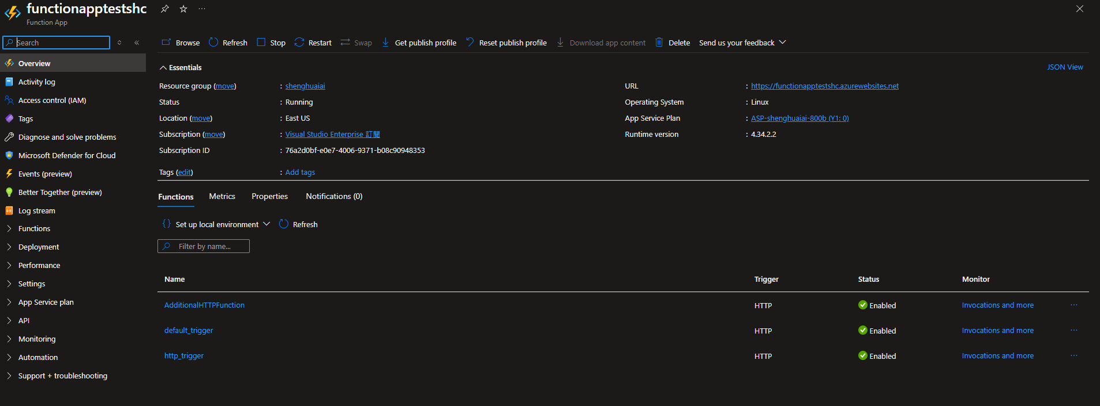
Deployment
https://www.youtube.com/watch?v=wUqohFhYHl0

